Slide 1
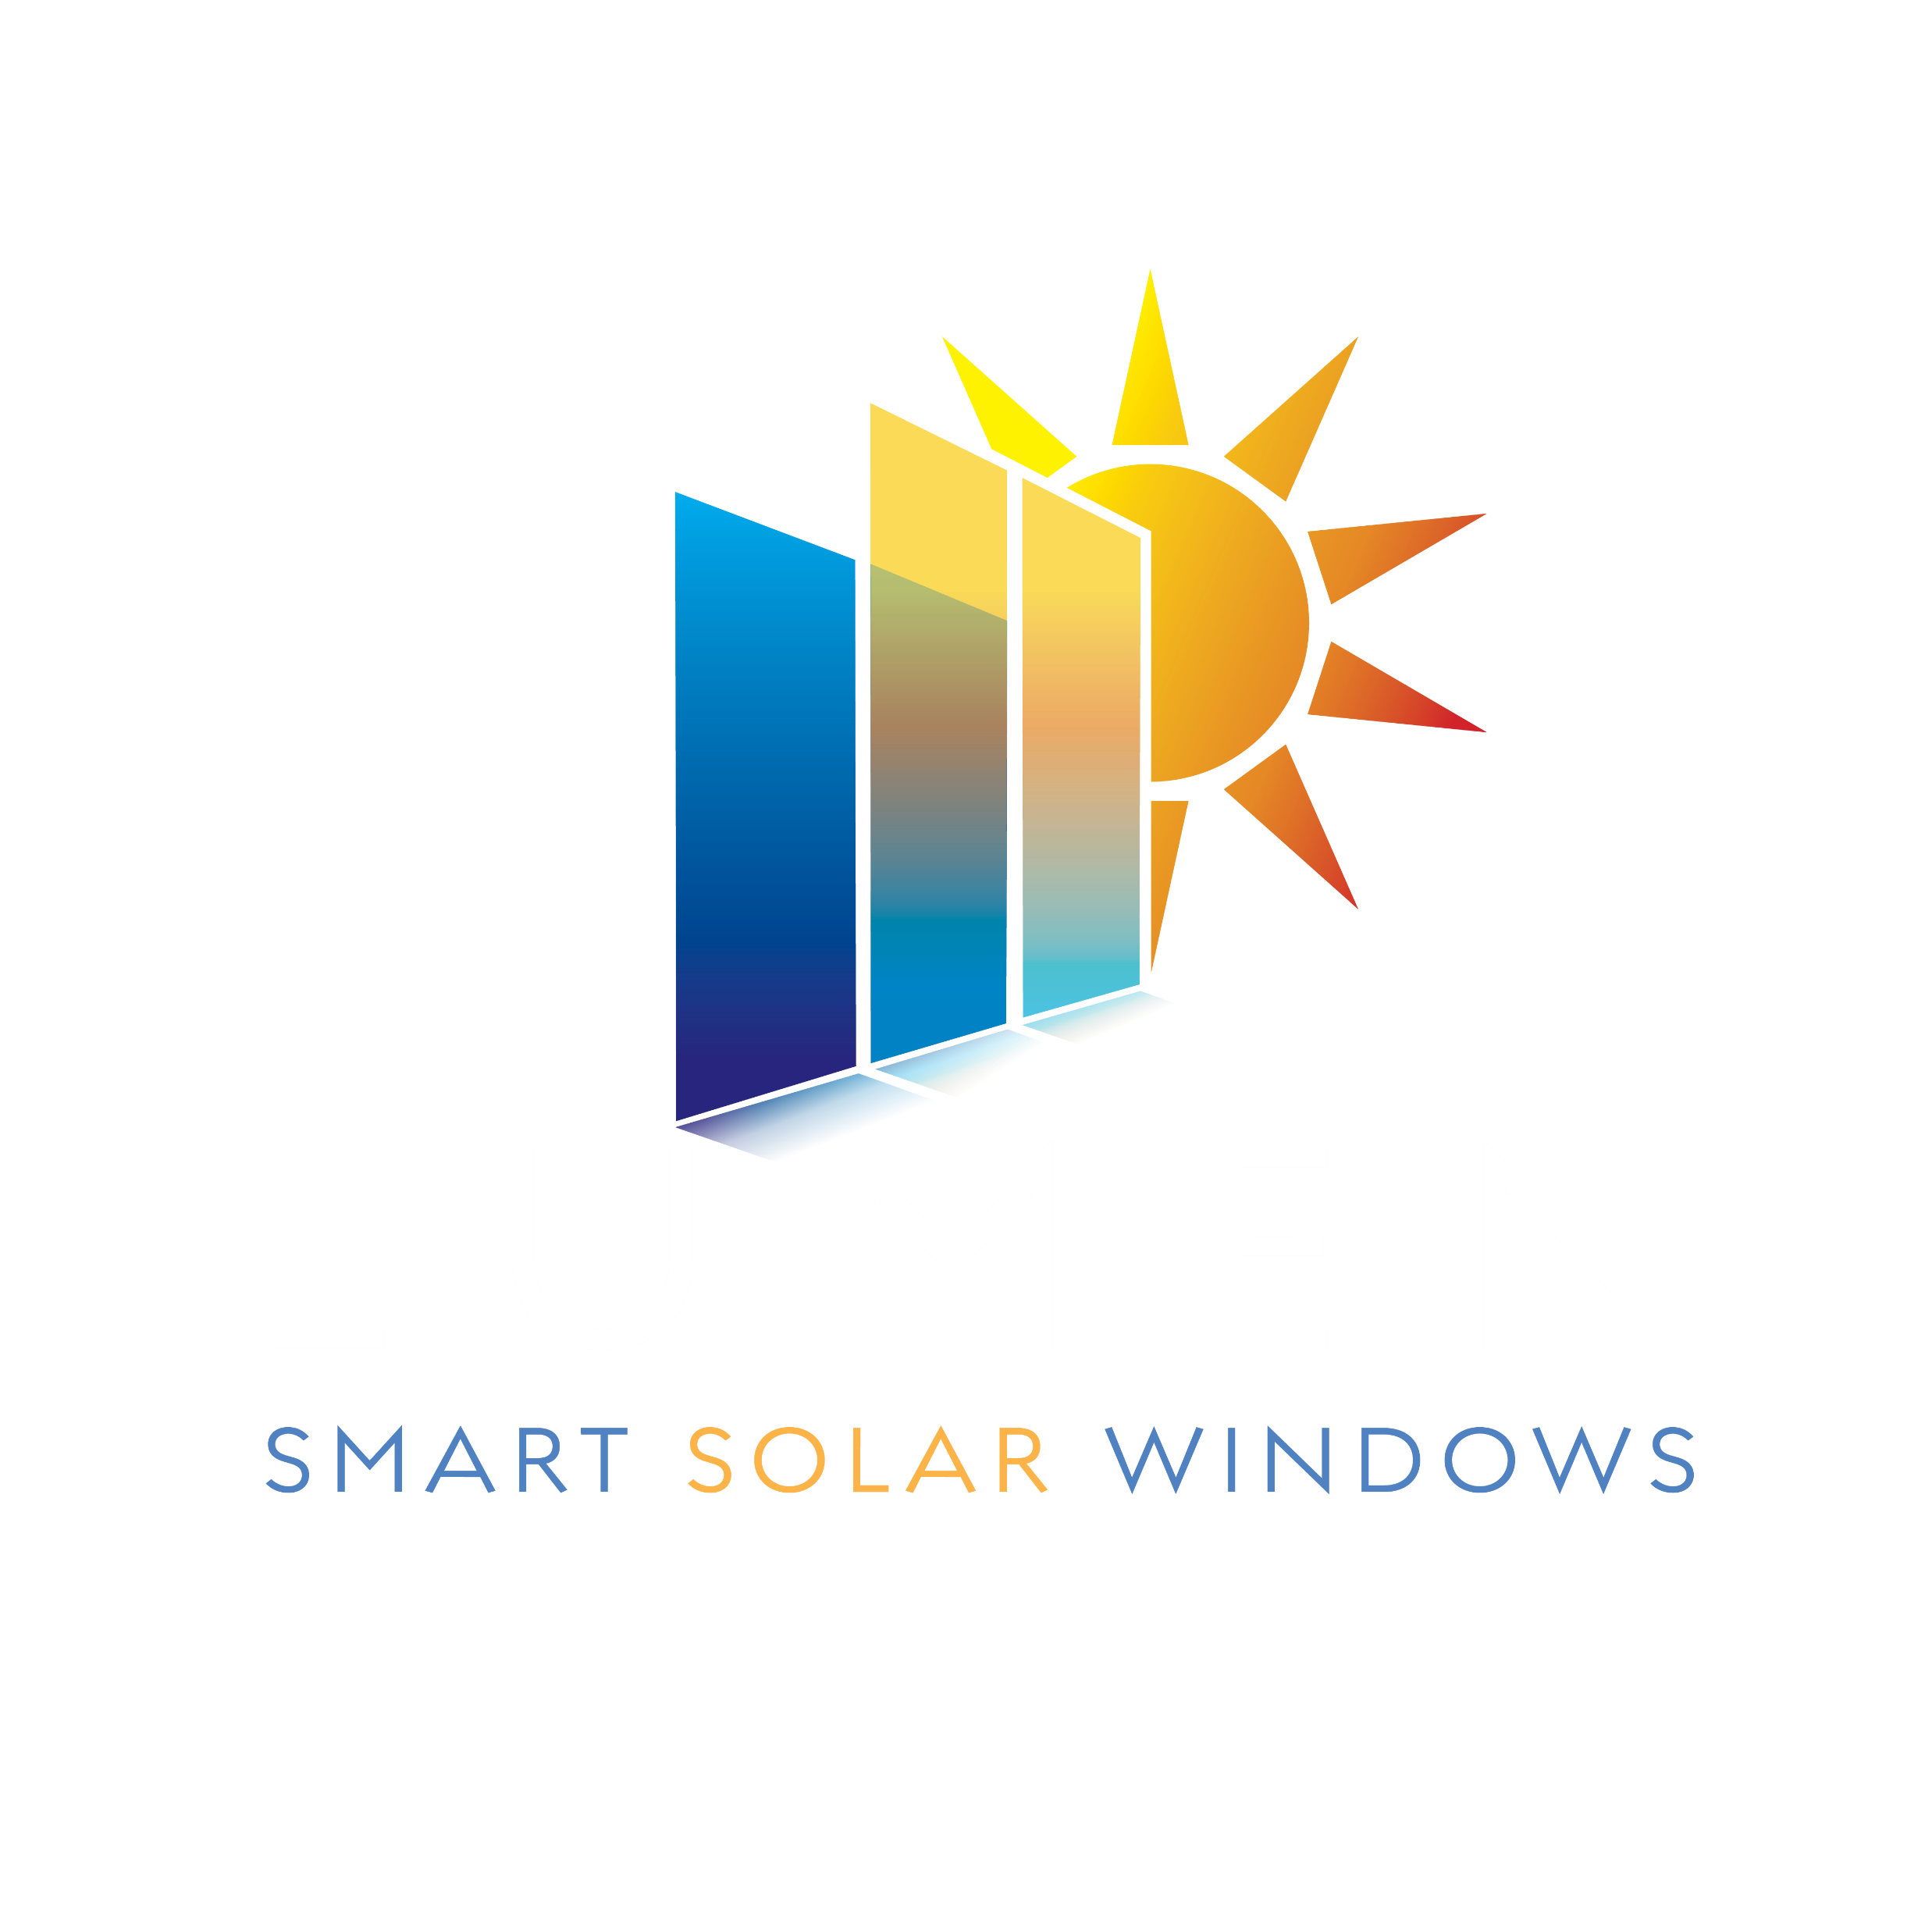
Lumen
Smart Solar Windows
Transforming Architecture with Futuristic Clean-Tech Solutions
Notes:
---

Slide 2



THE SUN.
93 MILLION MILES AWAY
POWERING OUR FUTURE
AND SAVING US FROM
FOSSIL FUEL
CONTAMINATION
The future of city planning just got powerfully amazing

Slide 3
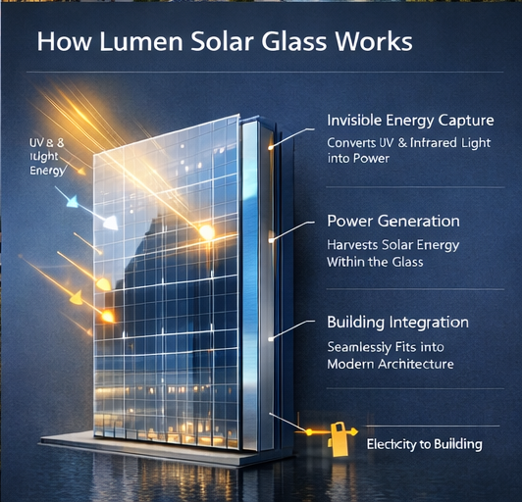

The future of city planning just got powerfully amazing
HOW IT
WORKS
Notes:
---

Slide 4
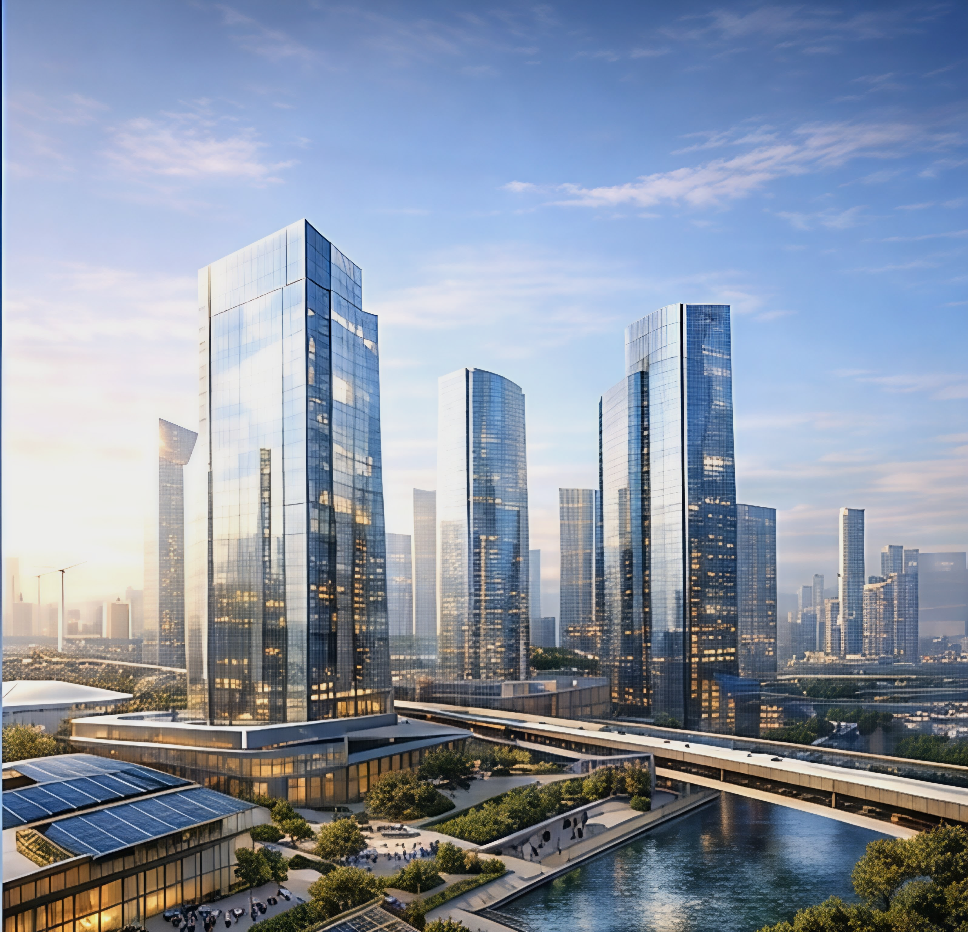
FUTURE BUILDINGS
The future of city planning just got powerfully amazing
ABLE TO POWER
THEMSELVES
AND ADJACENT
BUILDINGS
Notes:
Vision & Value Proposition: Revolutionizing Urban Energy with Smart Solar Windows, Product Architecture: Design, Technology, and Performance Features, Market Opportunity: Target Segments and Business Model, Roadmap & Impact: Future Developments and Sustainability Goals

Slide 5
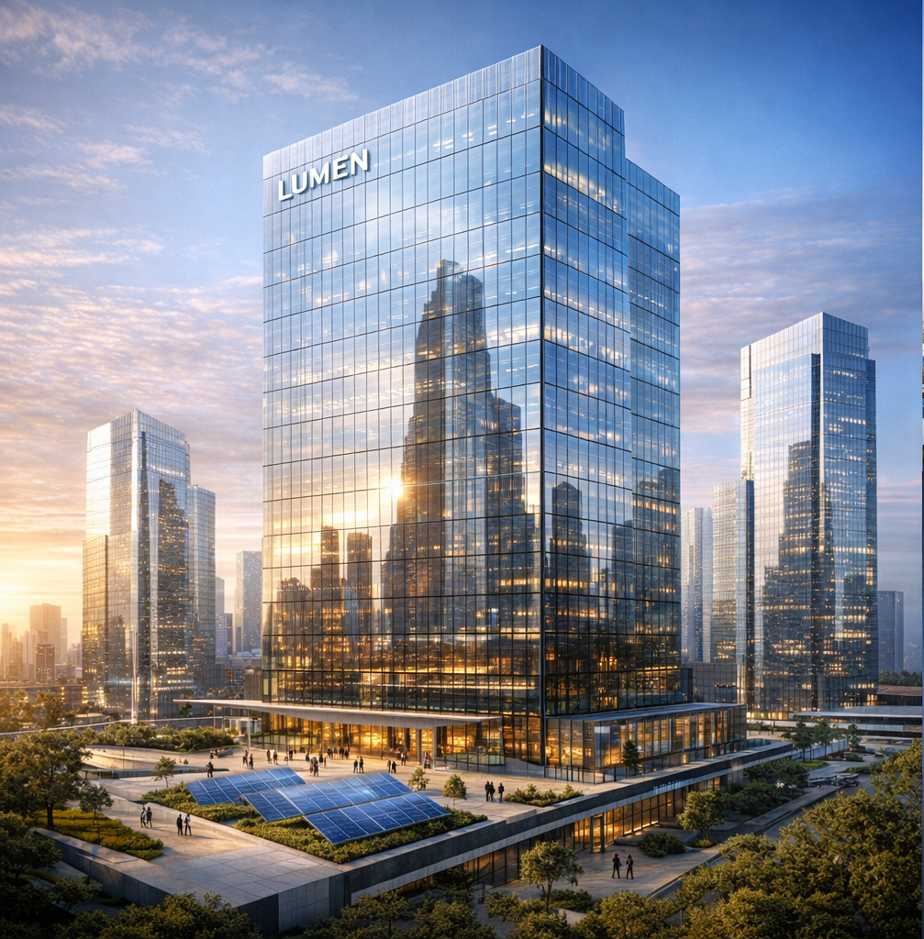
The future of city planning just got powerfully amazing
THE LUMEN BUILDING
IS OPERATED BY A COMPUTER, AI, AND REDUNDANT SYSTEMS

Slide 6
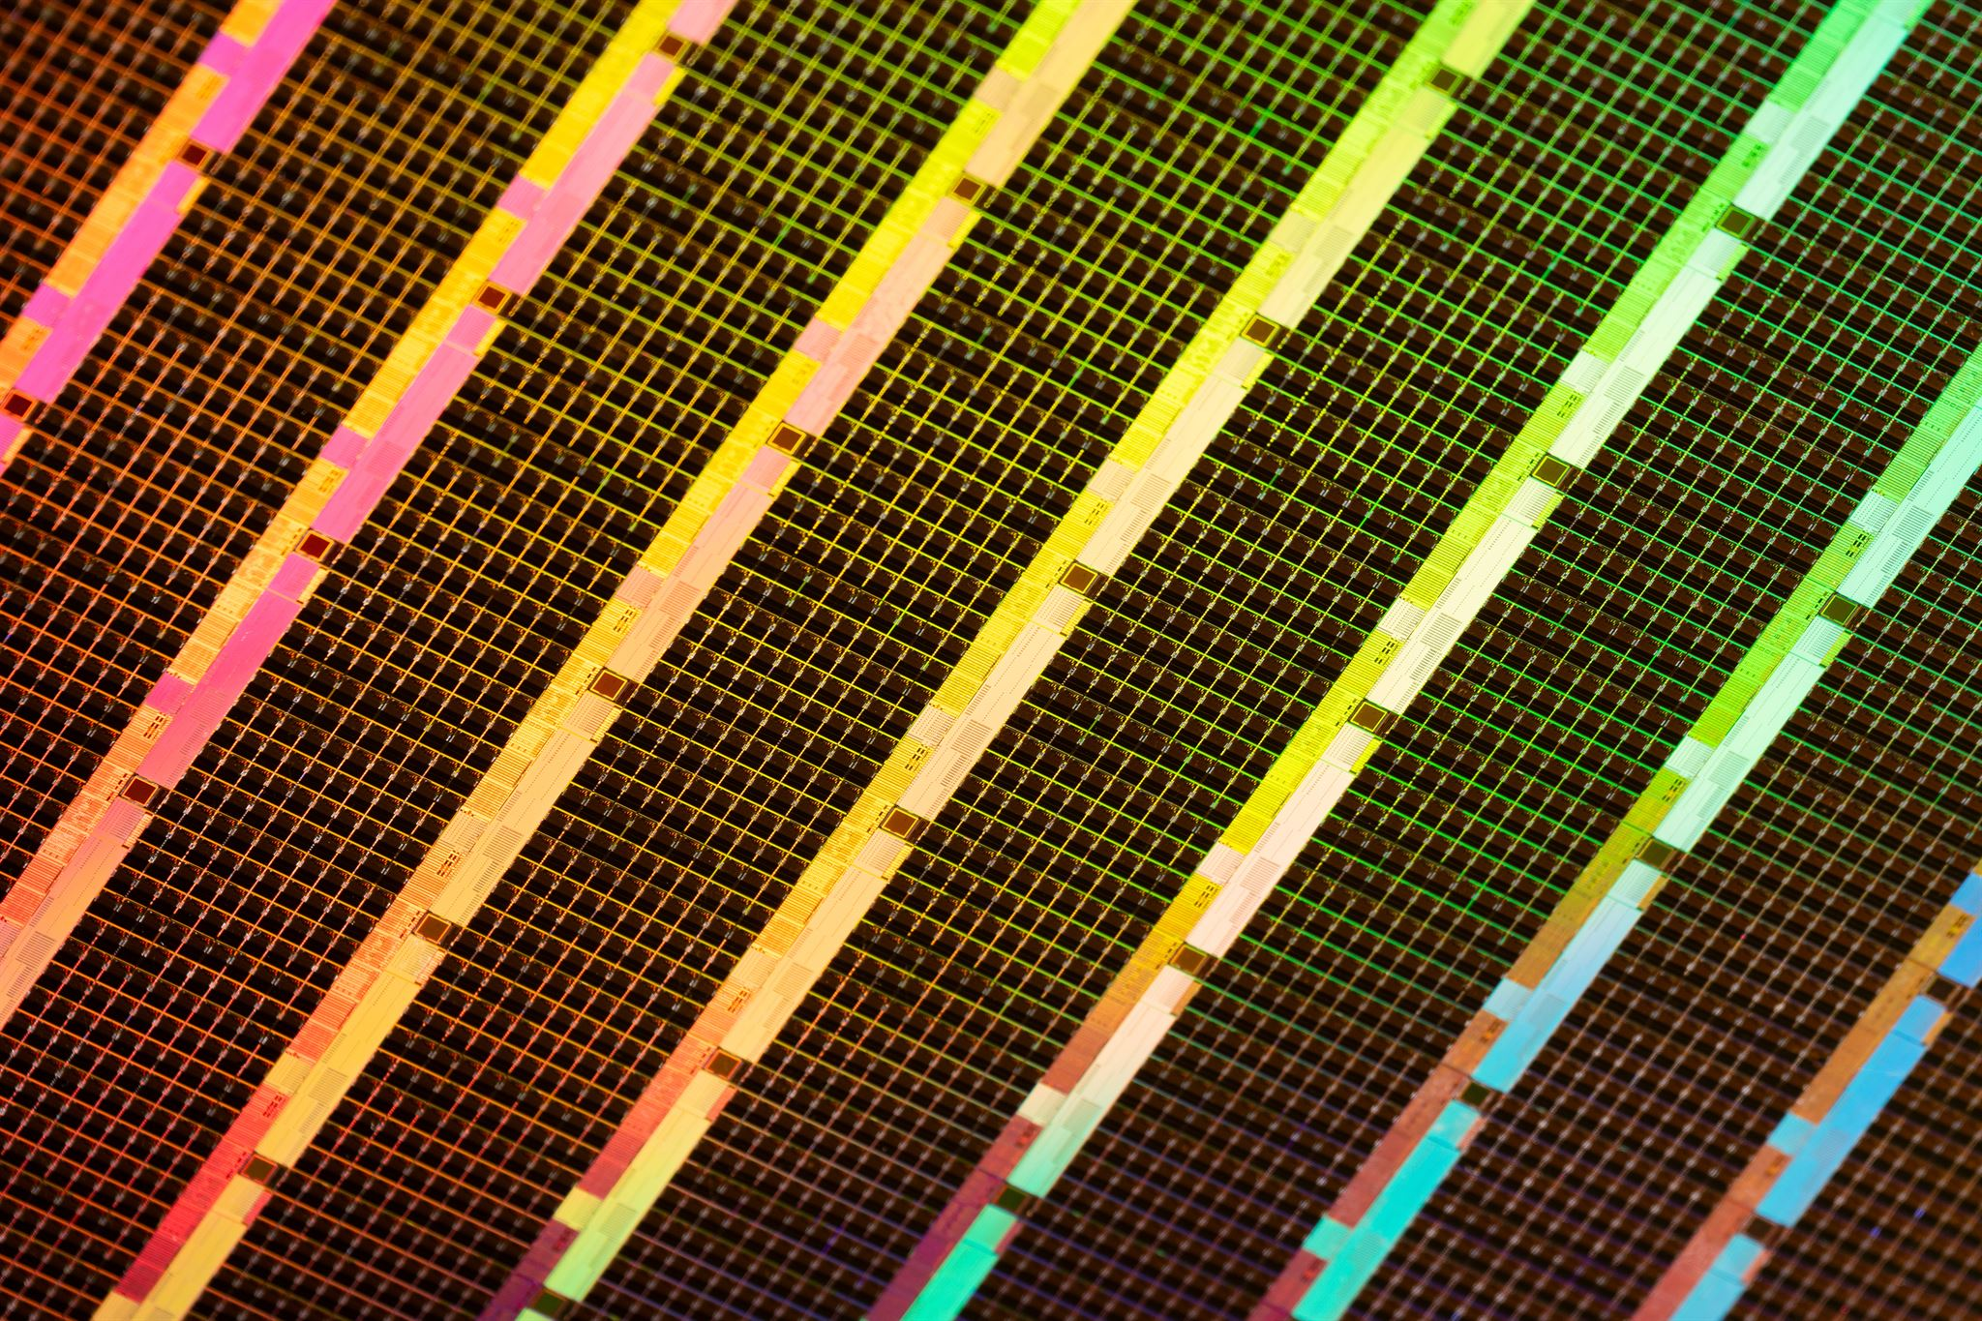
Product Architecture:
Design, Technology, and Performance Features
The future of city planning just got powerfully amazing
Innovative Photovoltaic Design
  Transparent solar cells embedded in tempered safety glass enable energy harvesting with high light transmission.
Advanced Technological Features
  Electrochromic layers provide customizable opacity, while self-cleaning coatings maintain efficiency and modular design eases installation.
Performance and Durability
  Energy conversion efficiency exceeds 15%, with durability meeting ASTM standards for impact and weather resistance.
Balanced Functionality and Comfort
  The product combines energy production with aesthetic appeal and occupant comfort in building applications.
Notes:
---
The product architecture combines transparent photovoltaic cells embedded in tempered safety glass, allowing for high visible light transmission while harvesting solar energy. Key technological features include customizable opacity levels via electrochromic layers, self-cleaning coatings to maintain efficiency, and modular design for easy installation and maintenance. Performance metrics demonstrate energy conversion efficiencies exceeding 15%, with durability ratings conforming to ASTM standards for impact resistance and weather tolerance. This innovation balances functional energy production with aesthetic and comfort considerations for building occupants.

Slide 7
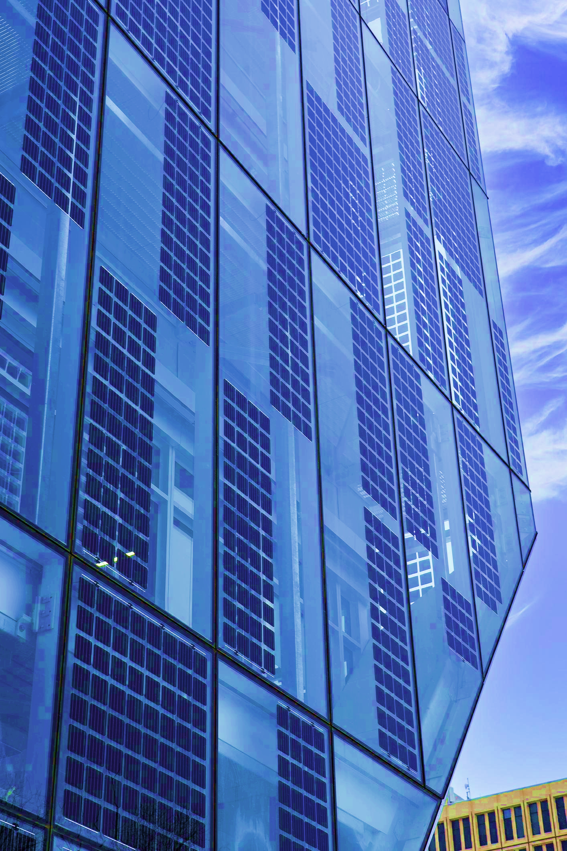
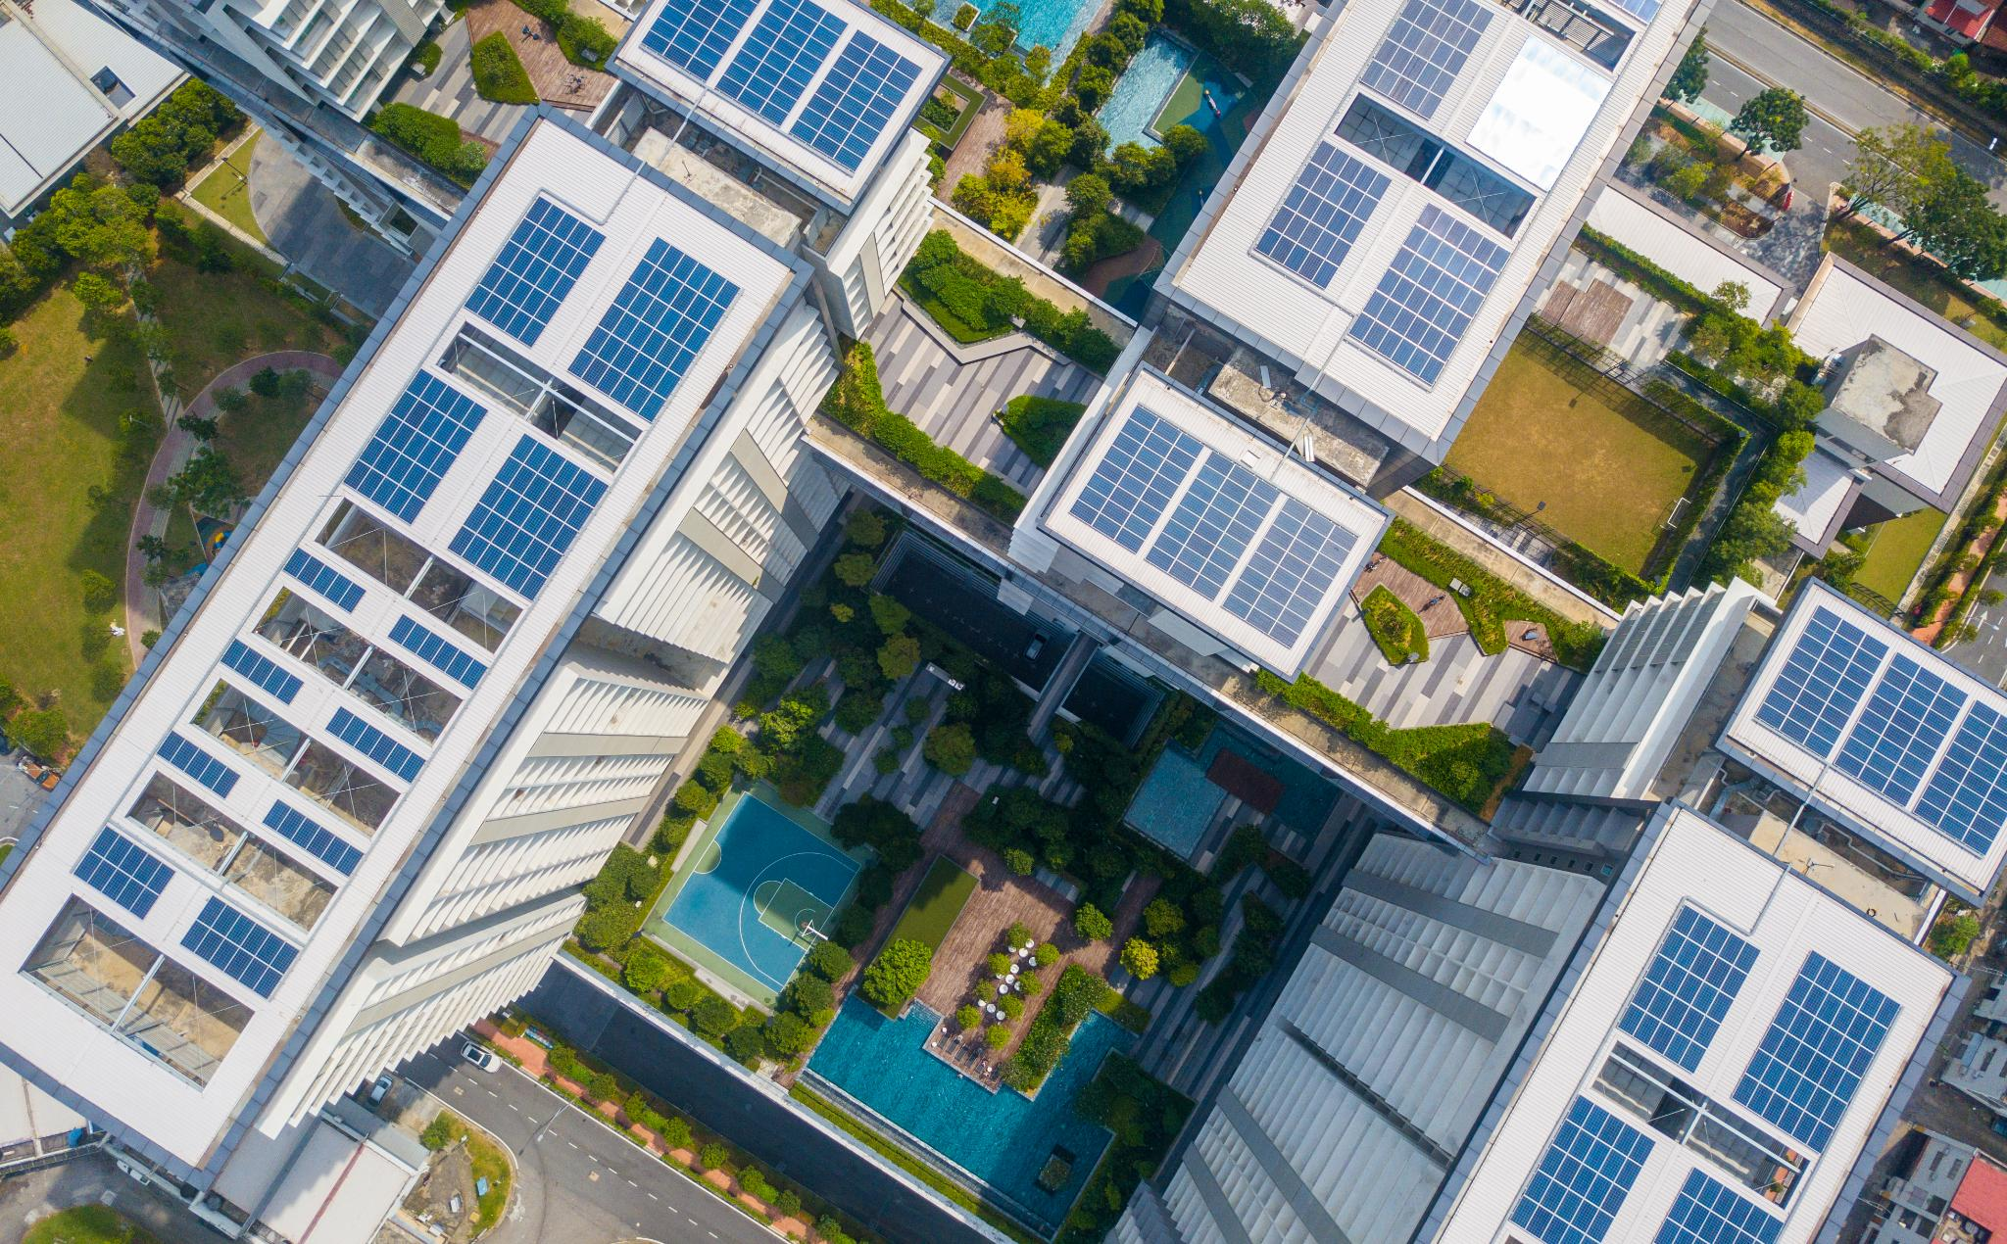
Roadmap & Impact:
Future Developments and Sustainability Goals
The future of city planning just got powerfully amazing
Manufacturing and Efficiency
  Roadmap focuses on scaling manufacturing and improving photovoltaic efficiency with novel materials.
IoT Integration
  Integrating IoT for real-time energy management and predictive maintenance enhances system performance.
Sustainability and SDGs
  Goals align with UN SDGs 7 and 11 to reduce carbon and promote net-zero energy buildings.
Projected Environmental Impact
  Expected CO2 reductions, energy cost savings, and urban resilience improvements by 2030.
Notes:
---
Lumen’s development roadmap includes scaling manufacturing capacity, enhancing photovoltaic efficiency through novel materials, and integrating IoT capabilities for real-time energy management and predictive maintenance. Sustainability goals align with UN Sustainable Development Goals (SDGs) 7 (Affordable and Clean Energy) and 11 (Sustainable Cities and Communities), aiming to reduce embodied carbon in building materials and enable net-zero energy building certifications. Projected impact metrics encompass annual CO2 emission reductions per installed MW, energy cost savings, and contribution to urban resilience under climate change scenarios by 2030.

Slide 8
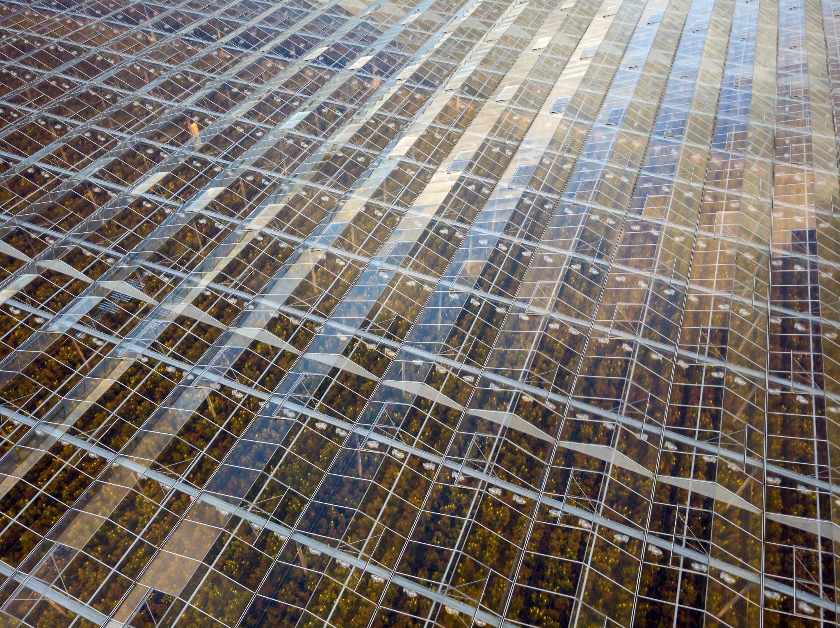
Vision & Value Proposition:
Revolutionizing Urban Energy with Smart Solar Windows
The future of city planning just got powerfully amazing
Photovoltaic Integration in Glass
  Smart solar windows embed advanced photovoltaic technology directly into architectural glass for passive energy generation.
Sustainable Urban Development
  This technology reduces fossil fuel reliance and lowers building carbon footprints in urban environments.
Market Demand & Net-Zero Goals
  Rising demand for energy-efficient, aesthetic smart materials aligns with global net-zero emission commitments.
Value Proposition Benefits
  Seamless integration, cost savings from energy generation, and enhanced occupant comfort via light modulation.
Notes:
---
Lumen Smart Solar Windows represent a breakthrough in sustainable urban development by integrating advanced photovoltaic technology directly into architectural glass. This enables buildings to generate clean energy passively, reducing reliance on fossil fuels and lowering carbon footprints. Market trends indicate a rising demand for smart building materials that combine energy efficiency with aesthetic appeal, positioning Lumen to capitalize on global commitments to net-zero emissions. Their value proposition hinges on seamless integration, cost savings through energy generation, and enhanced occupant comfort via dynamic light modulation.

Slide 9
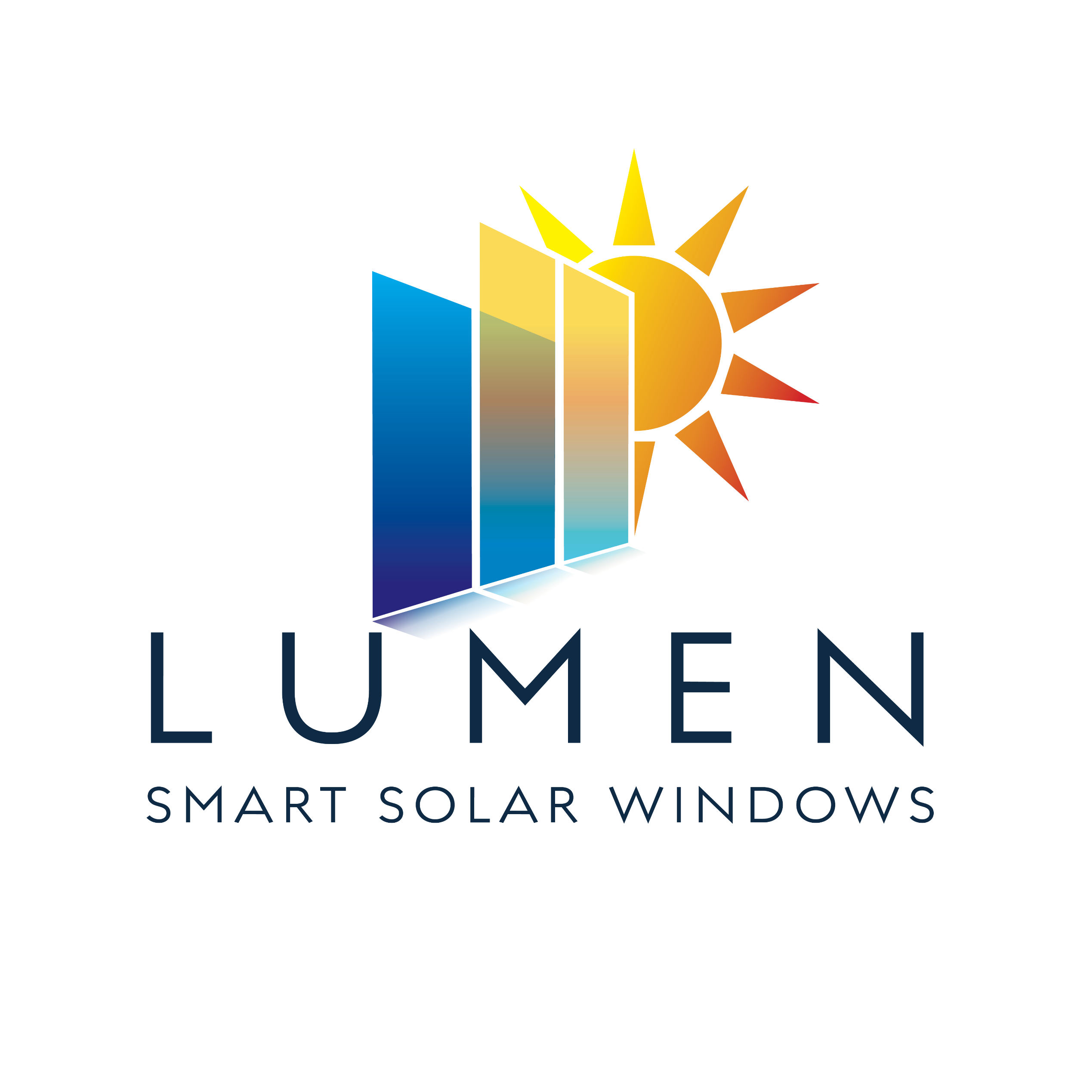
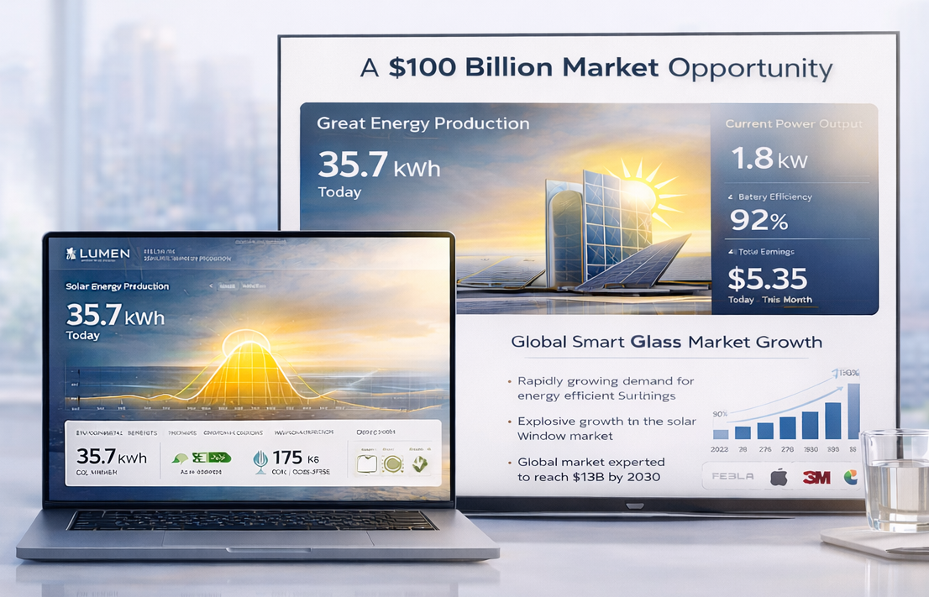
Market Opportunity:
Target Segments and Business Model
The future of city planning just got powerfully amazing
Target Market Segments
  Lumen focuses on commercial real estate, high-rise residential, and retrofitting projects as key market segments.
Market Growth Drivers
  The smart window market is expected to grow over 15% CAGR, fueled by green building demand and regulations.
Business Model Approach
  Lumen uses direct-to-developer sales plus partnerships with architects and construction firms, exploring leasing and energy-as-a-service.
Regional Expansion Opportunities
  North America, Europe, and Asia-Pacific urban hubs offer expansion potential due to active green building incentives.
Notes:
---
Lumen targets commercial real estate developments, high-rise residential buildings, and retrofitting projects as primary market segments. The global smart window market is projected to grow at a CAGR of over 15% in the next five years, driven by increasing regulatory pressures and consumer demand for green buildings. Lumen’s business model leverages a direct-to-developer sales approach supplemented by strategic partnerships with architects and construction firms, complemented by potential for leasing models or energy-as-a-service contracts. Regional expansion opportunities center around North America, Europe, and Asia-Pacific urban hubs with active green building incentives.

Slide 10
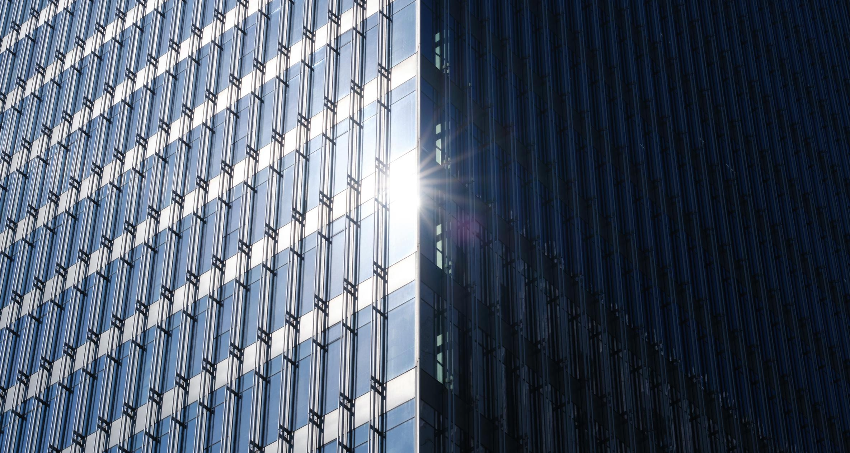
Conclusion:
Empowering the Future with Smart Solar Window Innovations
The future of city planning just got powerfully amazing
Innovative Energy Solutions
  Smart solar windows offer a cutting-edge solution that combines advanced technology with innovative design for urban energy needs.
Market Potential
  These solar windows have significant market potential due to their ability to integrate clean energy into urban architecture.
Sustainability Impact
  Smart solar windows promote sustainability by enabling renewable energy integration and reducing building carbon footprints.
Notes:
In conclusion, Lumen's smart solar windows represent a groundbreaking approach to urban energy solutions, combining innovative design and advanced technology. This portfolio highlights the market potential and sustainability impact, paving the way for future developments that transform architecture while promoting clean, renewable energy integration in buildings.

